Slide 1
Analysis of female employment against socioeconomic factors
Bhagyasree-160121729003
Sneha-160121729013
Rishitta-160121729006
Rithika-160121729016

Slide 2
AGENDA
Introduction
Problem Statement
Description
Data set
Experimental Results
Inferences and Conclusion
References

Slide 3
introduction
Several factors contribute to the low female employment rate around the world, as engineers going to the working sector in a few years, we were interested in the factors responsible for the wage gap and low female employment rates.
As part of the process we had come across an interesting dataset of the factors that affect the female employment in Bangladesh, including limited access to education and training, social norms that discourage women's participation in the labor force, lack of childcare facilities, and the prevalence of gender-based violence and harassment.
Addressing these challenges and promoting gender equality can help to increase the participation of women in the workforce, which could have positive effects on the country's overall economic growth and development.

Slide 4
Problem statement
According to a 2018 report by the World Bank, the global economy is losing around $160 trillion in wealth due to differences in lifetime earnings between women and men.
According to the World Health Organization (WHO), the estimated population of women in Bangladesh in 2021 is 77.05 million, while the estimated population of men is 77.47 million.
According to the World Bank, the female employment rate in Bangladesh was 36.9% in 2020. This figure is relatively low compared to the male employment rate, which was 79.7% in the same year

Slide 5
DESCRIPTION
PerFemEmploy Employment to population ratio (%) of women who are of age 15 or older. Employment to population ratio is the proportion of a country's population that is employed.
FertilityRate Fertility rate refers to the number of children born to women of childbearing age in a given population. It is typically measured as the number of live births per 1,000 women of reproductive age (usually defined as ages 15-49) in a particular year.
RatioMaletoFemale Ratio of female to male labor force participation rate Ratio of female to male labor force participation rate is calculated by dividing female labor force participation rate by male labor force participation rate and multiplying by 100.

Slide 6
PerFemEmployers Employers, female (% of female employment). Employers are those workers who, working on their own account or with one or a few partners, hold the type of jobs defined as a "self-employment jobs"
Agriculture Employment in agriculture, female (% of female employment).. The agriculture sector consists of activities in agriculture, hunting, forestry and fishing
Industry Employment in industry, female (% of female employment). The industry sector consists of mining and quarrying, manufacturing, construction, and public utilities (electricity, gas, and water

Slide 7
Services Employment in services, female (% of female employment). The services sector consists of wholesale and retail trade and restaurants and hotels; transport, storage, and communications; financing, insurance, real estate, and business services
Wage.Salaried Wage and salaried workers, female (% of female employment). Wage and salaried workers (employees) are those workers who hold the type of jobs defined as "paid employment jobs
ContrFamWorkers Contributing family workers, female (% of female employment). Contributing family workers are those workers who hold "self-employment jobs" as own-account workers in a market-oriented establishment operated by a related person living in the same household.

Slide 8
OwnAccount Own-account female workers (% of employment). Own-account workers are workers who, working on their own account or with one or more partners, hold the types of jobs defined as "self-employment jobs" and have not engaged on a continuous basis any employees to work for them. Own account workers are a subcategory of "self-employed".
Vulnerable Vulnerable employment, female (% of female employment). Vulnerable employment is contributing family workers and own-account workers as a percentage of total employment.

Slide 9
DATA set
Source:
Kaggle
Dataset Name: Female Employment vs Socioeconomic factors
This Data set is taken from
https://www.kaggle.com/datasets/mdmuhtasimbillah/female-employment-vs-socioeconimic-factors
Format: CSV File
Size:
There are a total of 11 rows consisting of the above mentioned attributes and 24 columns mentioning years from 1995 to 2019
24*11

Slide 10
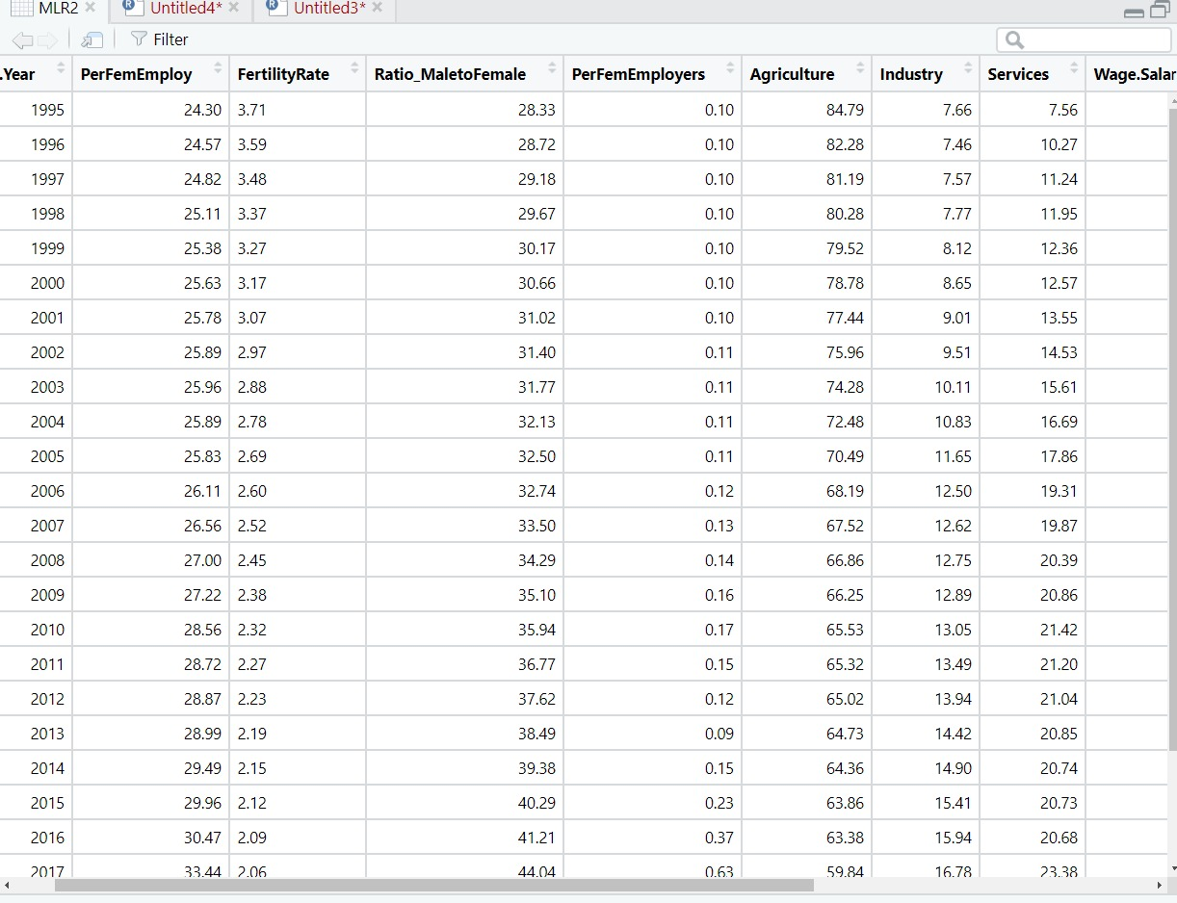
DATA set

Slide 11
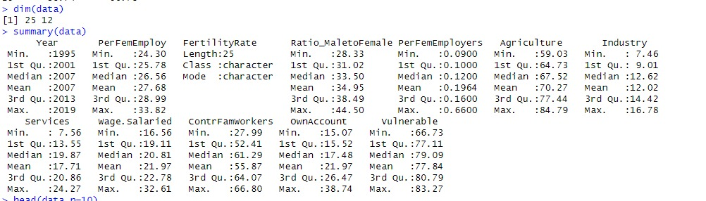
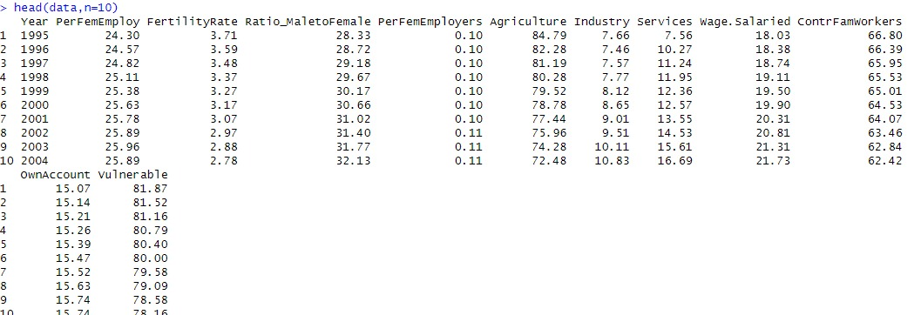
Experimental resULTS
CODE

Slide 12

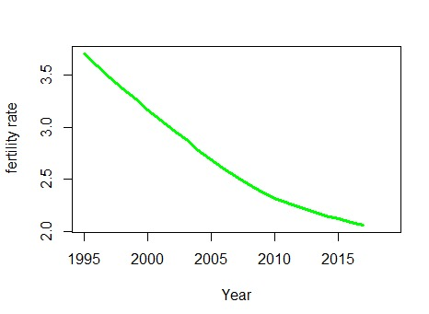
Experimental resULTS

Slide 13

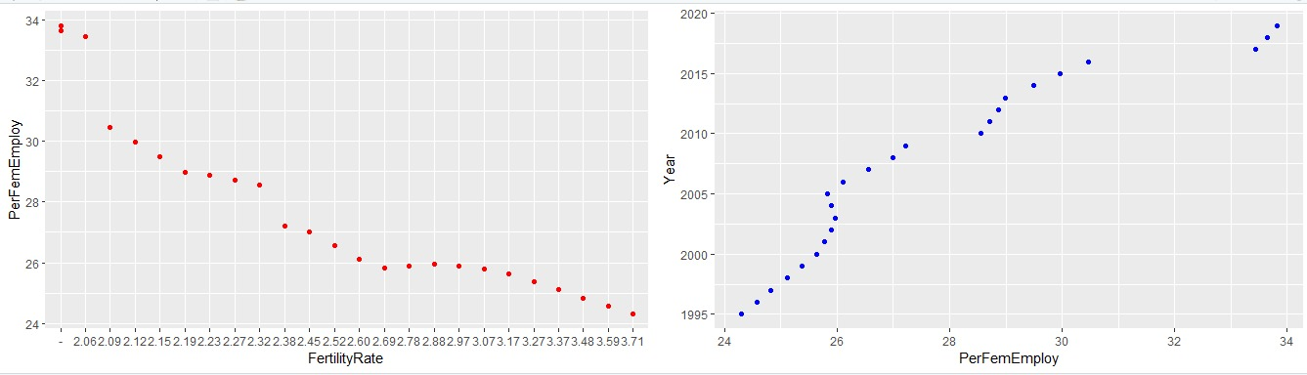
Experimental resULTS

Slide 14
Inferences
FROM THE LINE PLOT WE CAN INFER THAT:
Fertility rate is decreasing over the years and according to the world bank the fertility rate in Bangladesh was 2.03 births per woman in 2020. This graph represents a decline in fertility from previous years, reflecting the impact of various factors such as increased access to family planning and maternal healthcare
FROM THE SCATTER PLOTS WE CAN INFER THAT:
As a correlation to the above graph, improvements in education and economic opportunities for women, and changing social norms have been a plus to Bangladesh.
Due to which we can see that in the two plots that the employment rate has been increasing when fertility is decreasing

Slide 15
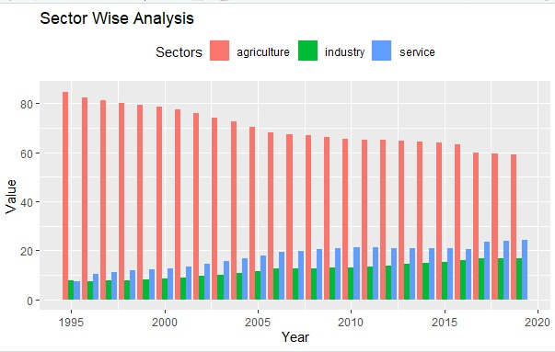
Experimental resULTS

Slide 16
Inferences
FROM THE BAR CHART WE CAN INFER THAT:
Initially from 1995 agriculture is relatively high compared to recent years compared to industry and service sectors
Over the years there is a decline in agriculture , but since it is always prevalent and a significant contributor to the GDP, there are a lot more female employees in the sector
But from the 2000s the industry and service sector started booming which is why we can see a steady increase in the chart since there is an increase in education

Slide 17
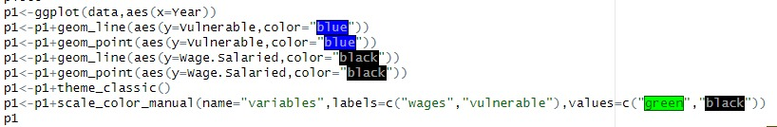
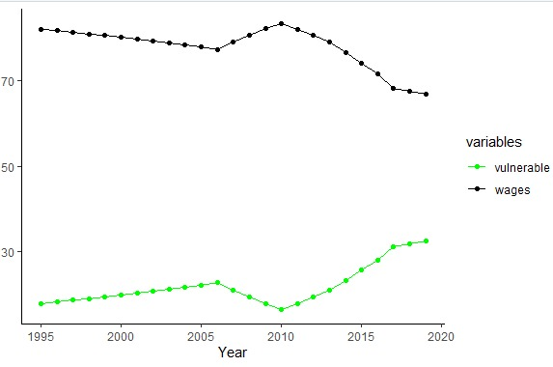
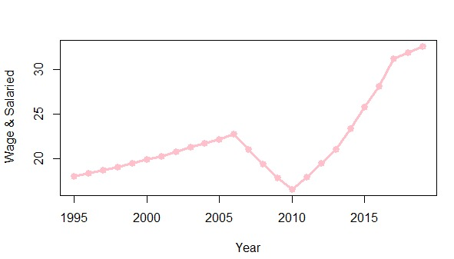
Experimental resULTS

Slide 18
Inferences
FROM THE LINE PLOT WE CAN INFER THAT:
From 1995 we can see a steady increase in the wages and salaries because there is an improvement in the economy, the drop in 2010 can be explained because of Bangladeshi inflation of 2010 due to which the economy crashed and after the recovery there is a steady increase again
From the multiple line graph, due to the increase in wage and salaries the amount of vulnerable women have been decreasing, there is a direct correlation.

Slide 19
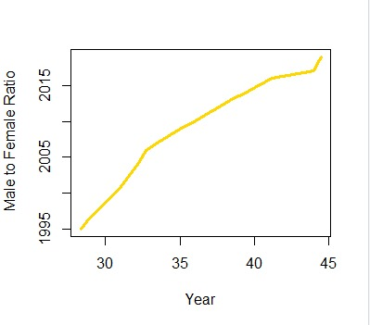
Experimental resULTS
CODE

Slide 20
Inferences
FROM THE LINE PLOT WE CAN INFER THAT:
Total number of male to females ratio is increasing so over the years the female labour force participation has been increasing

Slide 21
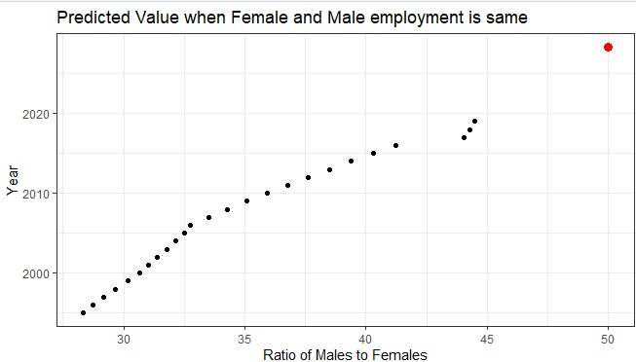
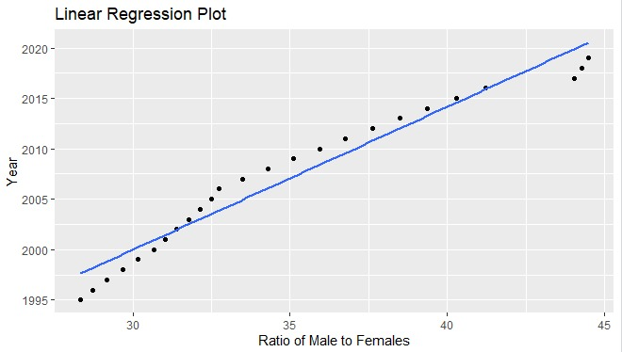
Experimental resULTS

Slide 22
Inferences
FROM THE LINE PLOT WE CAN INFER THAT:
Total number of male to females ratio is increasing so over the years the female labour force participation has been increasing

Slide 23
R GRAPHS
There are hundreds of charts and graphs present in R. For example, bar plot, box plot, mosaic plot, dot chart, coplot, histogram, pie chart, scatter graph, etc.
Types of R – Charts
Bar Plot or Bar Chart
Pie Diagram or Pie Chart
Histogram
Scatter Plot

Slide 24
TOOLS Used

Slide 25
Bar Plot or Bar Chart:
Bar plot or Bar Chart in R is used to represent the values in data vector as height of the bars. The data vector passed to the function is represented over y-axis of the graph. Bar chart can behave like histogram by using table() function instead of data vector.
Syntax: barplot(H,xlab,ylab,main, names.arg,col)
H is a vector or matrix containing numeric values used in a bar chart
Xlab is the label for x axis
Ylab is the label for y axis
Main is the title of the bar chart
Names.arg is a vector of names appearing under each bar
Col is used to give colours to the bars in the graph

Slide 26
Line Graph:
A line chart is a graph that connects a series of points by drawing line segments between them.These points are ordered in one of their coordinate value.Line charts are usually used in identifying the trends in data.
Syntax: plot(v,type,col,xlab,ylab)
• v is a vector containing the numeric values. a type takes the value "p" to draw only the points, "I" to draw only the lines and "o" to draw both points and lines.a xlab is the label for x axis. a ylab is the label for y axis.
• main is the Title of the chart.
• col is used to give colors to both the points and lines

Slide 27
Pie chart:
Pie chart is a circular chart divided into different segments according to the ratio of data provided. The total value of the pie is 100 and the segments tell the fraction of the whole pie. It is another method to represent statistical data in graphical form and pie() function is used to perform the same.
Syntax: pie(x, labels, col, main, radius)
x is a vector containing the numeric values used in the pie chart.
labels is used to give description to the slices.
radius indicates the radius of the circle of the pie chart. (value between -1 and +1)
main indicates the title of the chart
col indicates the color palette.
clockwise is a logical value indicating if the slices are drawn clockwise or anti clockwise

Slide 28
Functions used
dim() function in R Language is used to get or set the dimension of the specified matrix, array or data frame. Parameters: x: array, matrix or data frame.
The summarize() function is used in the R program to summarize the data frame into just one value or vector.
The head() function in R is used to display the first n rows present in the input data frame.
The tail() function in the R is particularly used to display the last n rows of the dataset, in contrary to the head() function
The names() function in R is used to get or set the name of an object. The object can be a list, vector, matrix, and DataFrame.
Colours is used to colour the graphs
label is used to assign a heading or a value to the axes of the graph

Slide 29
Libraries used
Patchwork is a package designed to make plot composition in R extremely simple and powerful. It is mainly intended for users of ggplot2 and goes to great lengths to make sure ggplots are properly aligned no matter the complexity of your composition.​

Slide 30
From the pie charts we can infer that
Number of Salaried jobs, self employment opportunities and women with their own account or women who are self employed have been increasing in 2019 compared to 1995, this indicates that young educated women in the urban sector are provided with more opportunities such as lending and access to credit and financial services and are encouraged to pursue
entrepreneurship

Slide 31
From the barplots we can infer that
The rural women participation rate may have risen due to expansion of livestock industry and other activities
based on microfinance, which depends mostly on female labor.
Generating non-farm self-employment requires skill and financial investment."
These trends show that females who work in industry or service as salaried worker or self employment have been increasing whereas the agriculture sector is decreasing

Slide 32
Conclusion

Slide 33
THANK YOU

